Slide 1
ElectroVision

Slide 2
Table of contents
Our Team
01.
ElectroVision
02.
Introduction
Objectives
03.
Cleaning Process
Report
Recommendations
04.
05.
06.

Slide 3
Our team
Khadiga Hisham
Karim Adel
Menna Mahmoud
Abdallah Elmallwany
Mahmoud Sayed
01.
ElectroVision

Slide 4
Introduction
ElectroVision
ElectroVision is a comprehensive data-driven project aimed at enhancing electricity management and service delivery.
02.

Slide 5
Project Objectives
ElectroVision
Monitor Power Outages: Provide real-time data on the frequency and causes of power outages across regions.
Enhance Decision-Making: Support decision-makers in identifying service gaps and improving electricity distribution.
Optimize Service Efficiency: Use data insights to reduce the duration of outages and improve response time.
Improve Customer Satisfaction: Incorporate customer feedback to optimize service delivery and customer support.
03.

Slide 6
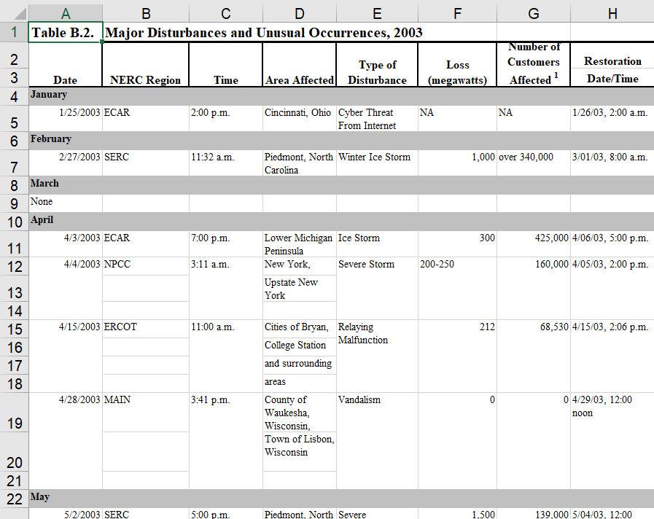
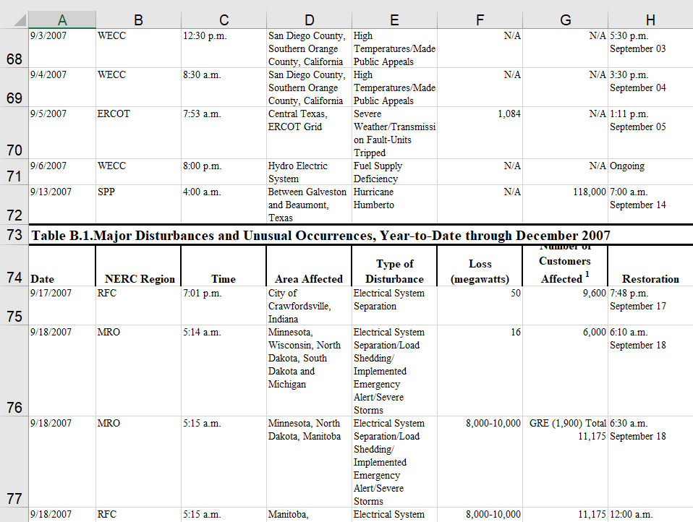
ElectroVision
Before Cleaning “On Excel”
04.

Slide 7
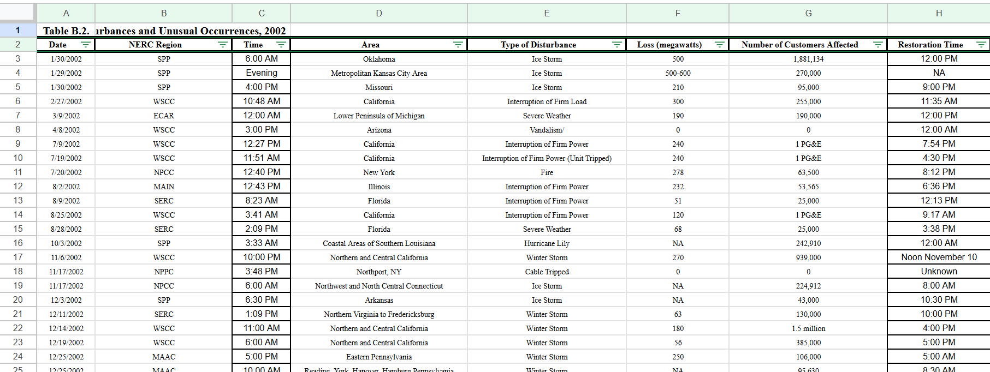
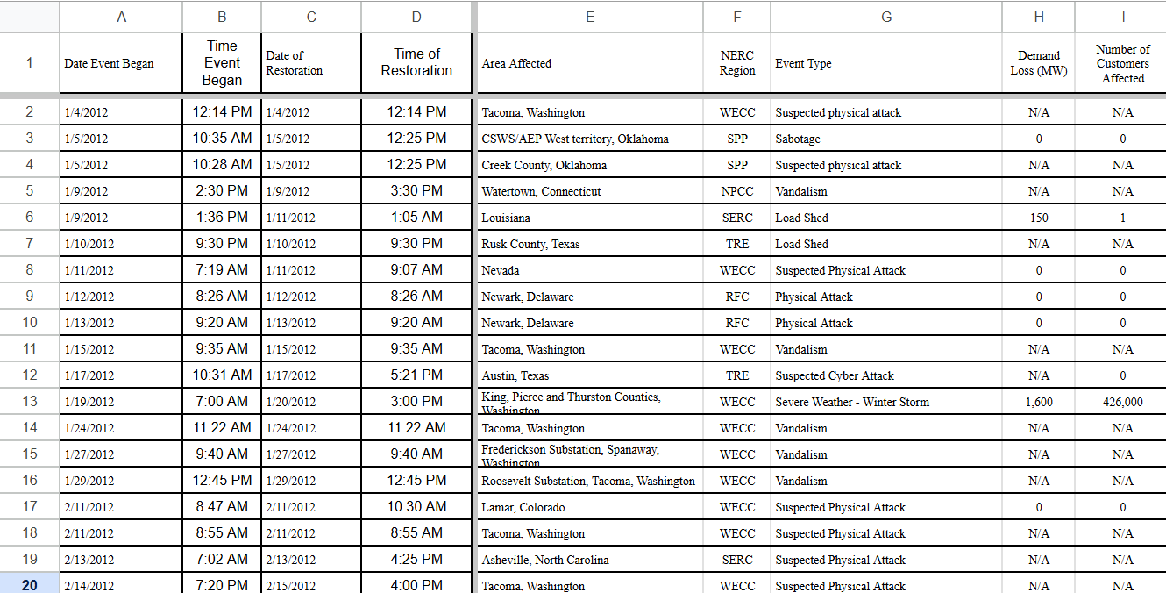
ElectroVision
After Cleaning “On Excel”
04.

Slide 8
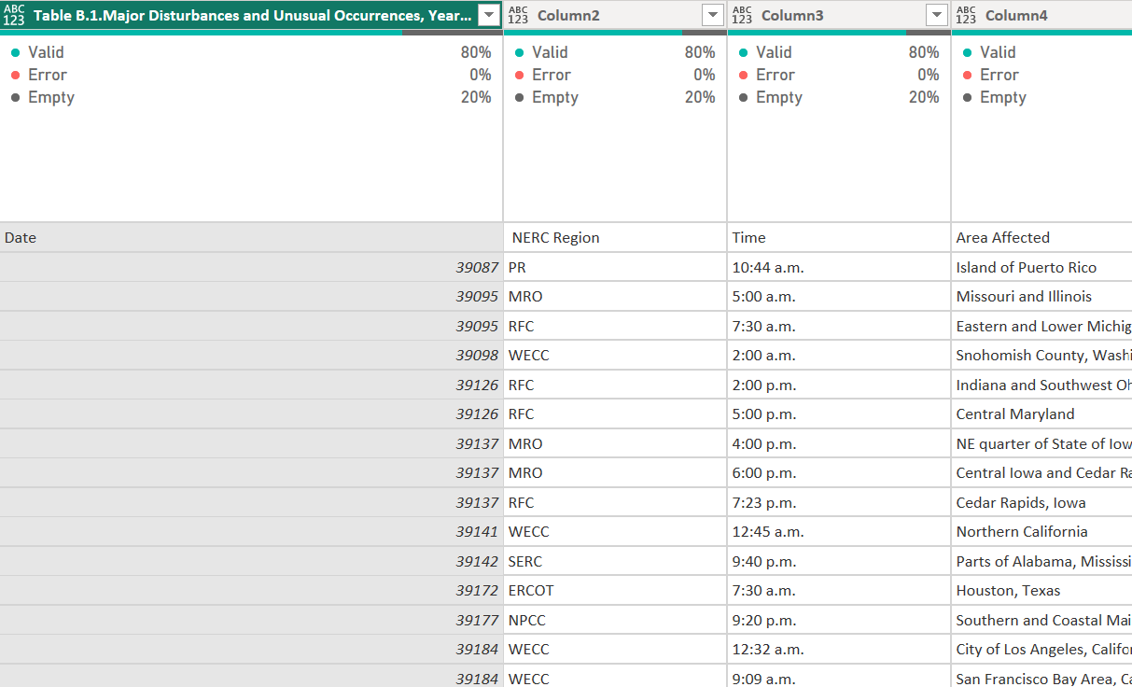
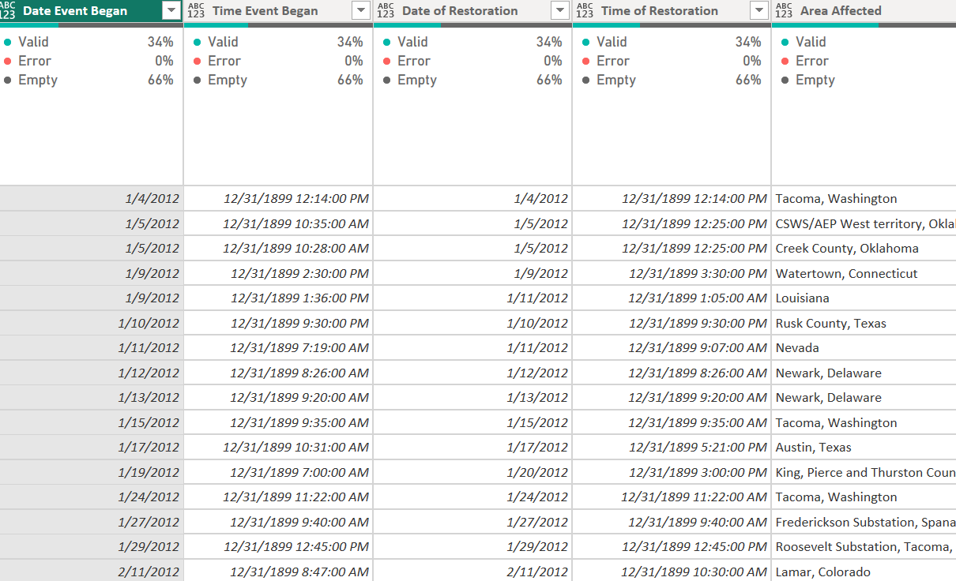
ElectroVision
Before Cleaning “On PowerQuery”
04.

Slide 9
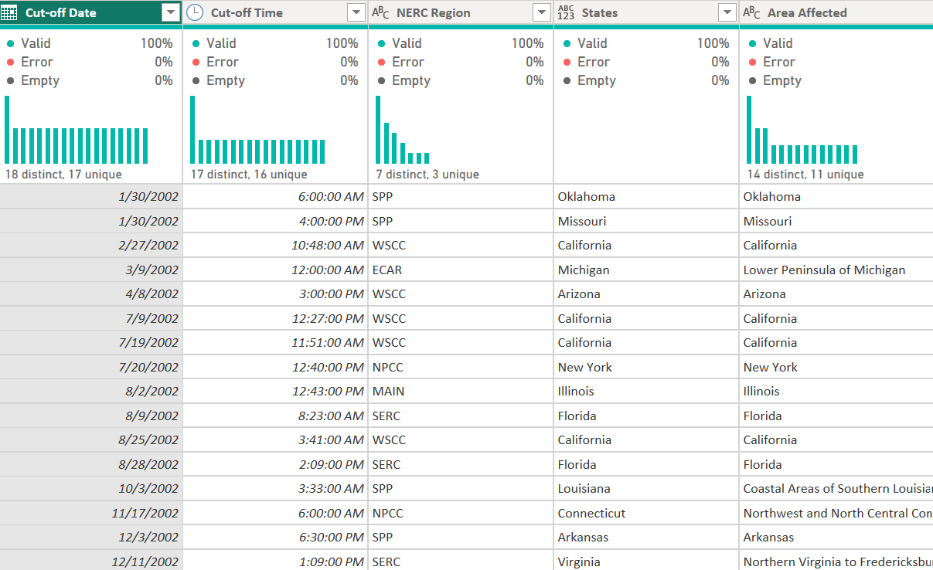
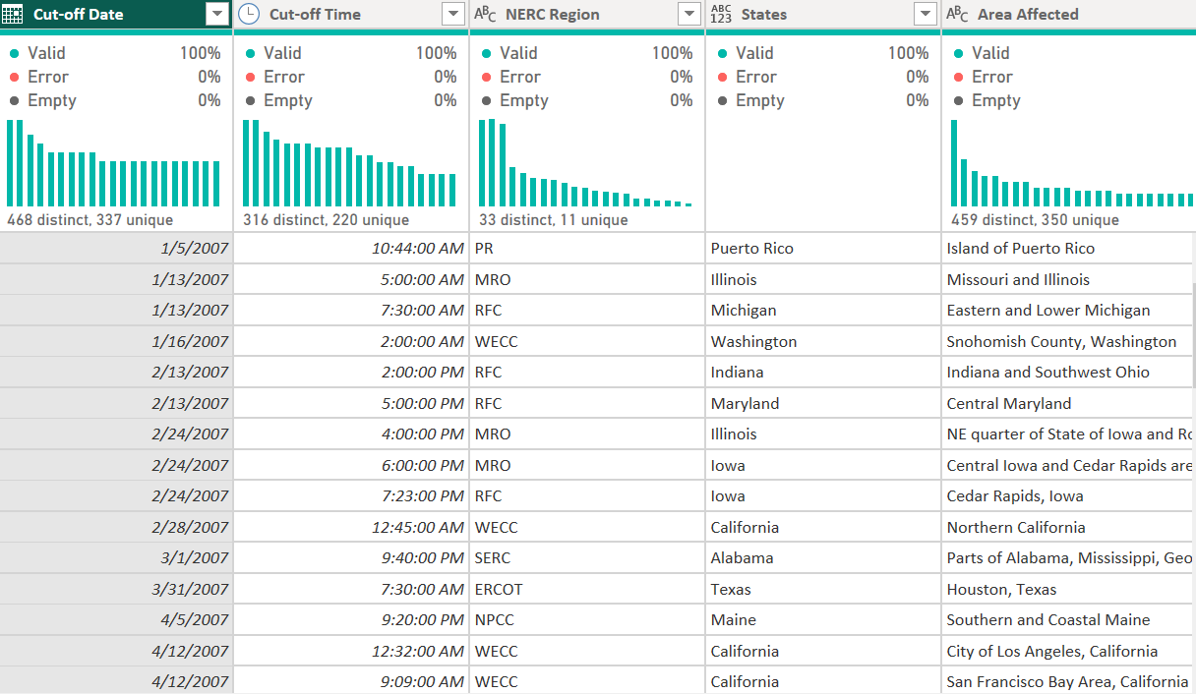
ElectroVision
After Cleaning “On PowerQuery”
04.

Slide 10
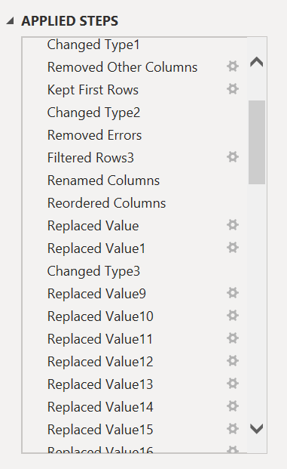
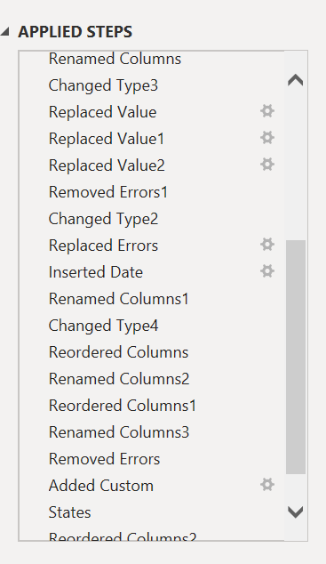
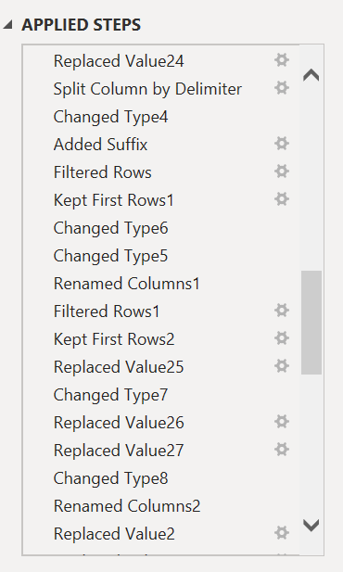
ElectroVision
Some of the applied steps on PowerQuery
04.

Slide 11

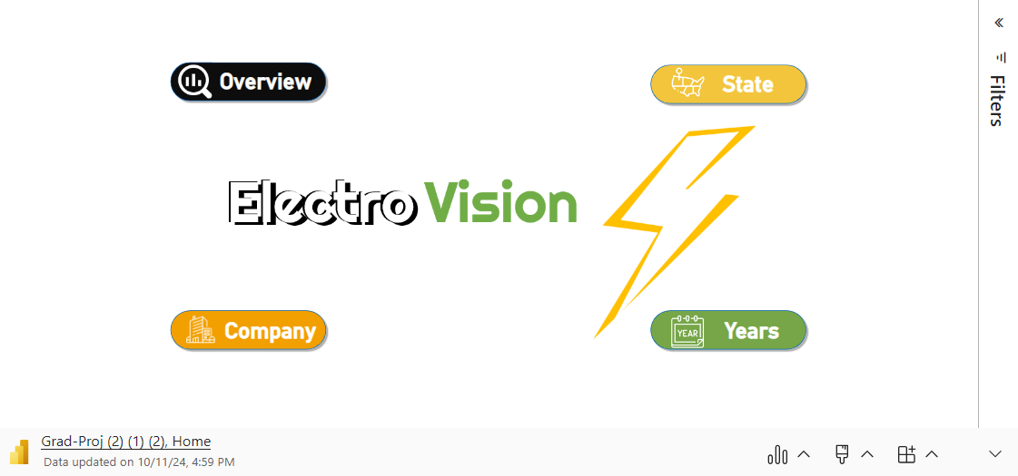
ElectroVision
05.
Microsoft Power BI

Slide 12
CTA 1 “Address High Cut-offs in WECC & SERC”
ElectroVision
Insight:
WECC has 952 cut-offs, which is significantly higher than other regions.
SERC reports 637 cut-offs, indicating a pressing need for improvement.
Recommendation: Improve infrastructure and adopt predictive maintenance to reduce outages.
Enhancement: Expected 15-20% reduction in cut-offs.
How We Get This Number: Based on past trends of infrastructure upgrades and maintenance efficiencies.
Reference: Energy Insights. (2020). Trends in Power Outages and Solutions. Retrieved from Energy Insights.
06.

Slide 13
CTA 2 “Combat Severe Weather Impacts”
ElectroVision
Insight:
Severe weather causes 732 outages, which is a major contributor to disruptions.
Recommendation: Implement grid-hardening measures and advanced weather forecasting techniques.
Enhancement: Anticipated 25-30% reduction in weather-related outages.
How We Get This Number: Derived from analysis of weather impact studies on outage frequency.
Reference: Utility Dive. (2022). Weather's Impact on Power Reliability. Retrieved from Utility Dive.
06.

Slide 14
CTA 3 “Reduce Restoration Time”
ElectroVision
Insight:
Restoration takes an average of 1 day, 7 hours, 38 minutes, impacting customer satisfaction.
Recommendation: Utilize smart grids and automation to expspped the restoration processes.
Enhancement: Projected 20-25% improvement in restoration time.
How We Get This Number: Based on improvements observed in utilities that adopted smart technologies.
Reference: Smart Energy International. (2022). Enhancing Restoration Times with Smart Technology. Retrieved from Smart Energy International.
06.

Slide 15
CTA 4 “Summer Outages”
ElectroVision
Insight:
Most outages (1052) occur in the summer, highlighting a seasonal risk.
Recommendation: Implement demand-response systems to manage peak loads and enhance grid reliability.
Enhancement: Expected 20-25% reduction in summer outages.
How We Get This Number: Informed by demand-response program evaluations showing reduced peak impacts.
Reference: International Energy Agency (IEA). (2021). Demand Response in the Energy Transition. Retrieved from IEA.
06.

Slide 16
CTA 5 “Winter Outages”
ElectroVision
Insight:
Customer impacts peak in December with 916 cut-offs, particularly during winter storms.
Recommendation: Reinforce infrastructure and ensure adequate winter preparations.
Enhancement: Anticipated 15-20% reduction in winter outages.
How We Get This Number: Based on historical data indicating lower outages after infrastructure reinforcement.
Reference: Grid Modernization Journal. (2020). Preparing for Winter: Infrastructure Needs and Solutions. Retrieved from Grid Modernization Journal.
06.

Slide 17
Dataset Reference:
ElectroVision
You can see the whole raw data through this link:
USA Electricity Dataset 2002-2023

Slide 18
Thank You!
ElectroVision

